Slide 1
PLASMA DONOR
IBM PROJECT

Slide 2
OBJECTIVES
Abstract
Introduction
Literaturea Survey
Application
Proposed System
System Requirements
System Architecture
Result
Conclusion

Slide 3
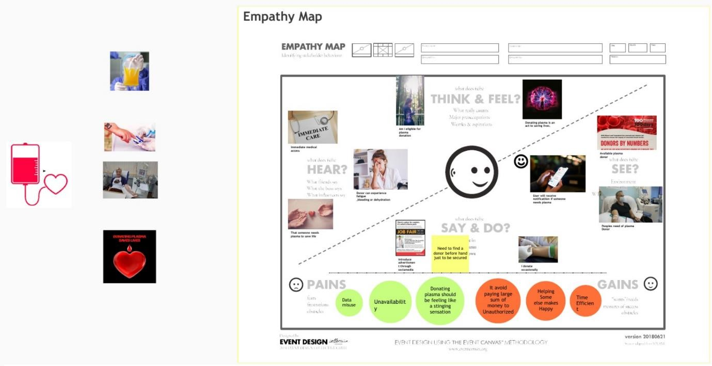
PATTERN

Slide 4
INTRODUCTION
What is Plasma Donation?
Plasma is the clear, straw-colored liquid portion of blood that remains after red blood cells, white blood cells, platelets and other cellular components are removed. It is the single largest component of human blood, comprising about 55 percent, and contains water, salts, enzymes, antibodies and other proteins.

Slide 5
ABSTRACT
During the COVID 19 crisis, the requirement of plasma became a high priority and the donor count has become low.
Saving the donor information and helping the needy by notifying the current donors list, would be a helping hand.
In regard to the problem faced, an application is to be built which would take the donor details, store them and inform them upon a request.
We created an application to improve the process of blood donation.

Slide 6
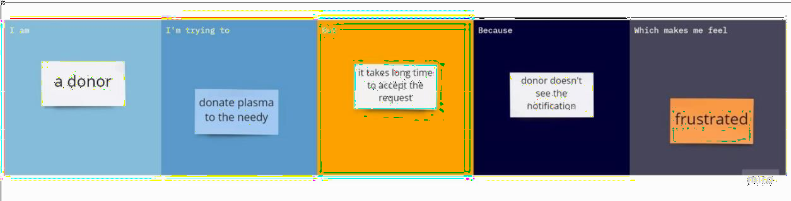
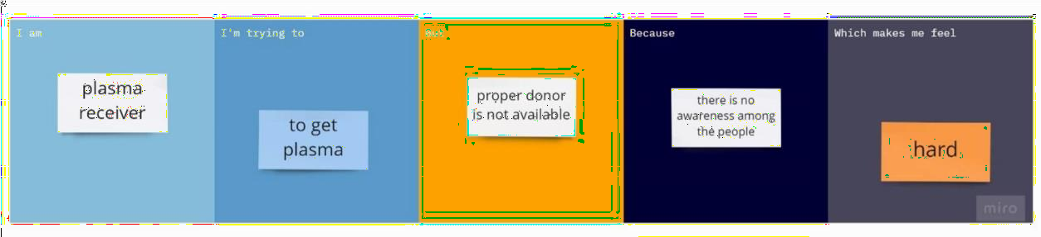
LITERATURE SURVEY

Slide 7
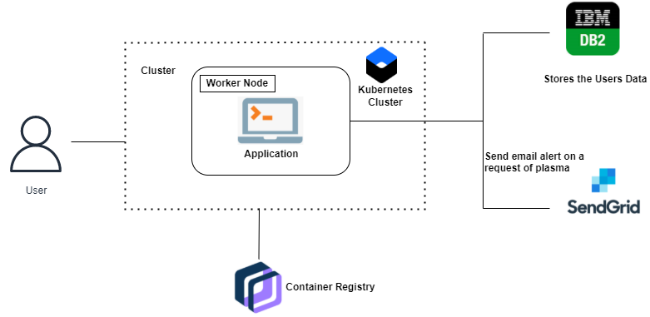
APPLICATION

Slide 8
PROPOSED SYSTEM
Solve complex problems in a way that fits the state of your customers.
Succeed faster and increase your solution adoption by tapping into existing mediums and channels of behavior.
Sharpen your communication and marketing strategy with the right triggers and messaging.
Increase touch-points with your company by finding the right problem-behavior fit and building trust by solving frequent annoyances, or urgent or costly problems.
Understand the existing situation in order to improve it for your target group

Slide 9
SYSTEM REQUIREMENTS
. REQUIREMENT ANALYSIS
Functional Requirements :
Following are the functional requirements of the proposed solution.
FR No. | Functional Requirement (Epic) | Sub Requirement (Story / Sub-Task)
FR-1 | User Registration | Registration through Website
FR-2 | User Confirmation | Confirmation via Email
FR-3 | User Login | Login using Registered email Id
FR-4 | Sent Request | If plasma is required, the receiver will contact the donor
FR-5 | Contact Donor | Contact the donor directly if a phone number is given
FR-6 | View donation camps | View the list of donation camps happening nearby

Slide 10
Non Functional requirements :
Following are the non-functional requirements of the proposed solution.
FR No. | Non-Functional Requirement | Description
NFR-1 | Usability | The user interface of the plasma donor system must be well-designed and welcoming.
NFR-2 | Security | Data storage is required by security systems, just like it is by many other applications. Databases are able to keep all the donor information that is viewed by applications. It must be secured with email Id and password.
NFR-3 | Reliability | The system has the ability to work all the times without failures apart from network failure. A donor can have the faith on the system. The authorities will keep the privacy of all donors in a proper manner
NFR-4 | Performance | The Plasma donor System must perform well in different scenarios. The system is interactive and delays involved are less.
NFR-5 | Availability | The system, including the online components, should be available 24/7.
NFR-6 | Scalability | The system offers the proper resources for issue solutions and is designed to protect sensitive information during all phases of operation.

Slide 11
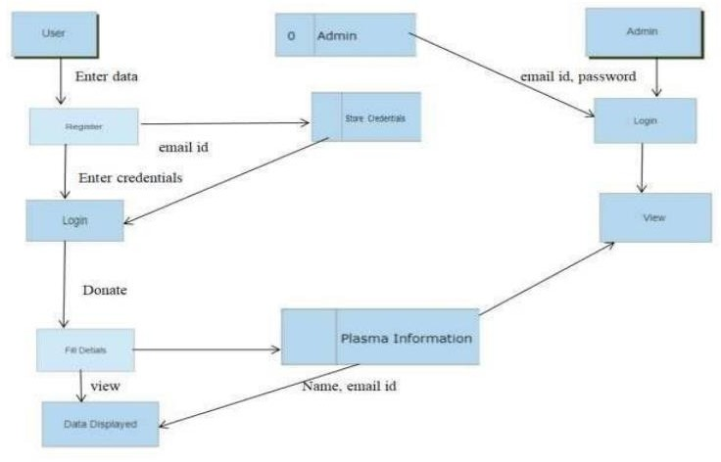
SYSTEM ARCHITECTURE

Slide 13
Add a Slide Title - 5

